Slide 1



Slide 2
Nanobiosensors

Slide 3
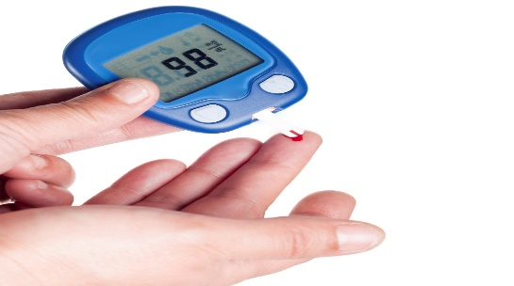
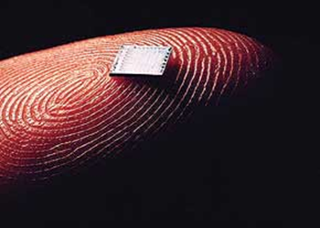
Biosensor
Biosensor is:
An analytical device which is used to detect a biological product.
A device that combines a biological recognition element with a physical or chemical transducer

Slide 4
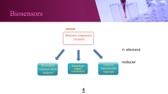
Components of Biosensors
Bioreceptors
A transducer
A signal processor

Slide 5
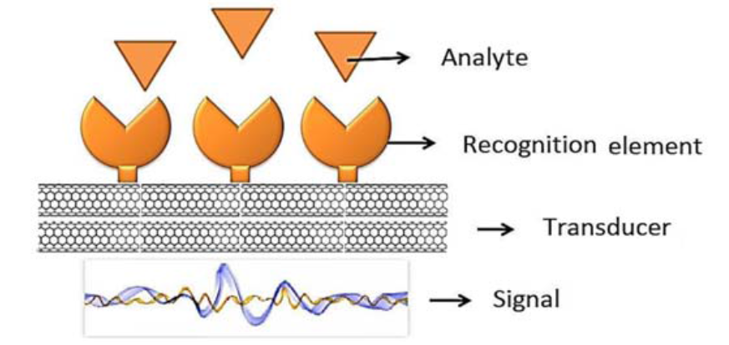
Biosensors

Slide 6
